Slide 1


Introduction
Uncovering Instagram's Impact on Cosmetics Purchasing
Research aims to reveal the nuanced impact of Instagram on consumer behavior
Significant for marketing strategy and empowering consumers
Crucial insight for businesses marketing beauty products
Aligns with social media influence frameworks

Slide 2
Research Question and Hypothesis
Probing the Research Gap
01
RQ: How does Instagram influence cosmetics purchases?
Hypothesis: Instagram has strong positive effect.
02
03
1+ billion active Instagram users make it pivotal.
A literature gap exists on Instagram's specific cosmetics impact.

Slide 3
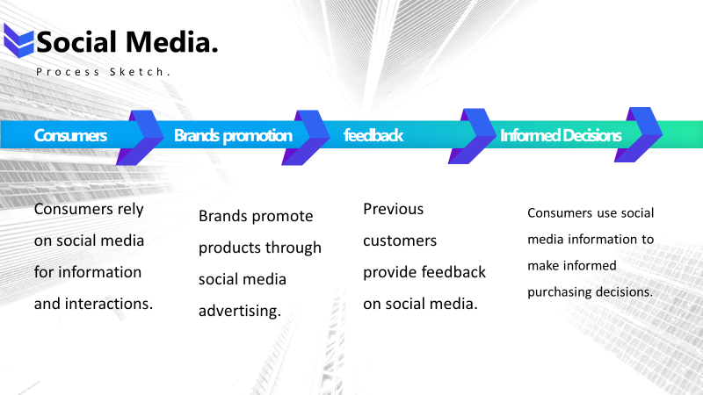
Process Sketch
Conceptualizing the Complex Process
Consumers rely on social media for information and interactions.
Visualizes the cyclical process between consumers, brands, and Instagram.
Compares Instagram impact vs. placebo condition.
Will collect robust qualitative and quantitative data.

Slide 4
Data Measurement and Collection
Multi-dimensional Data Collection
Three key data points include:
Website Traffic
Conversion Rates
Consumer Surveys
Web analytics via Google Analytics pixel tracking.
Surveys administered through Qualtrics.
Statistical analysis of survey responses with SPSS.
Comparing experimental conditions to give insight into consumer behaviour.

Slide 5
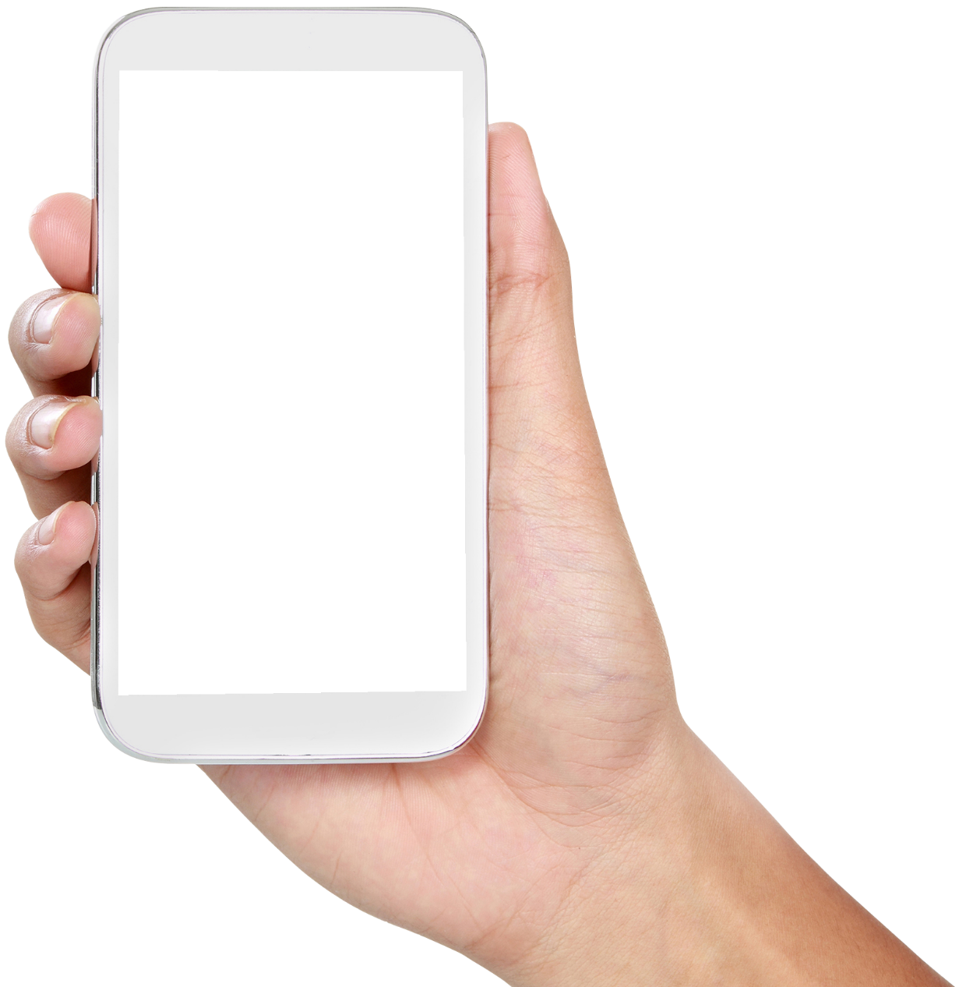
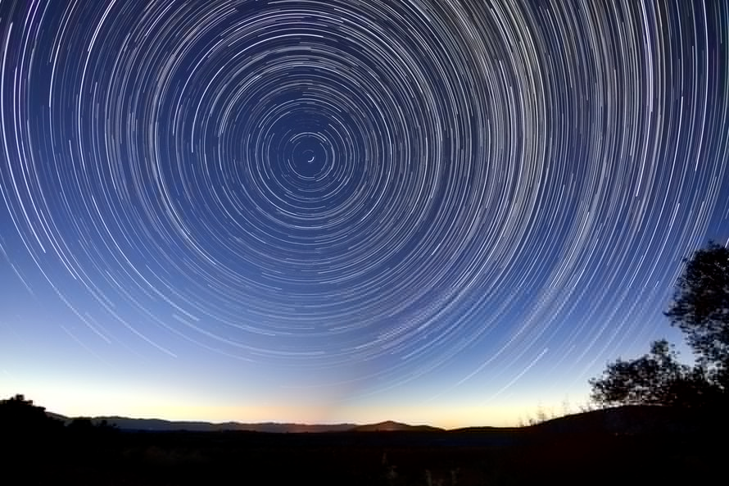
Logistic Considerations
Ensuring Research Rigor

Slide 6
Potential Challenges and Mitigation
Limitations and Mitigation Strategies

Slide 7
Thank You

